Slide 1
LINKED LIST

Slide 2
DATA STRUCTURE
A data structure is a specialized format for organizing, processing, retrieving and storing data.
Data Structures are widely used in almost every aspect of Computer Science,
Compiler Design,
Operating Systems,
Graphics,
Artificial Intelligence, and many more.

Slide 3
DATA STRUCTURE
Primitive Data Structure
Non- Primitive Data Structure
Integer
Linear Data Structure
Non-Linear Data Structure
Float
Static
Dynamic
Graph
Character
Queue
Array
Tree
Boolean
Stack
Linked List

Slide 4
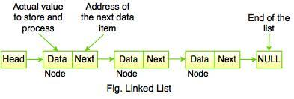
Linked list
A linked list is a sequence of data structures, which are connected together via links.
It is a linear data structure, in which the elements are not stored at contiguous memory locations. The elements in a linked list are linked using pointers.
Linked list is the second most-used data structure after array.

Slide 5

Types of linked list
There are three common types of Linked List:
Singly Linked List
Doubly Linked List
Circular Linked List
Singly Linked List:

Slide 6
Singly Linked List
Node is represented as:
struct node
{
int data;
struct node *next;
};
Data | next

Slide 7
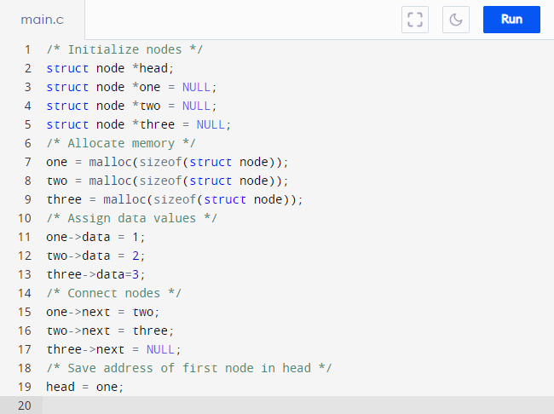
Simple Linked List with three items to understand how this works :

Slide 8
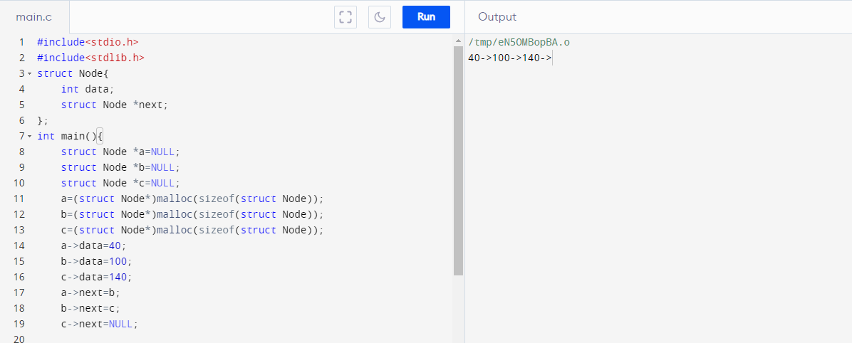

Slide 9
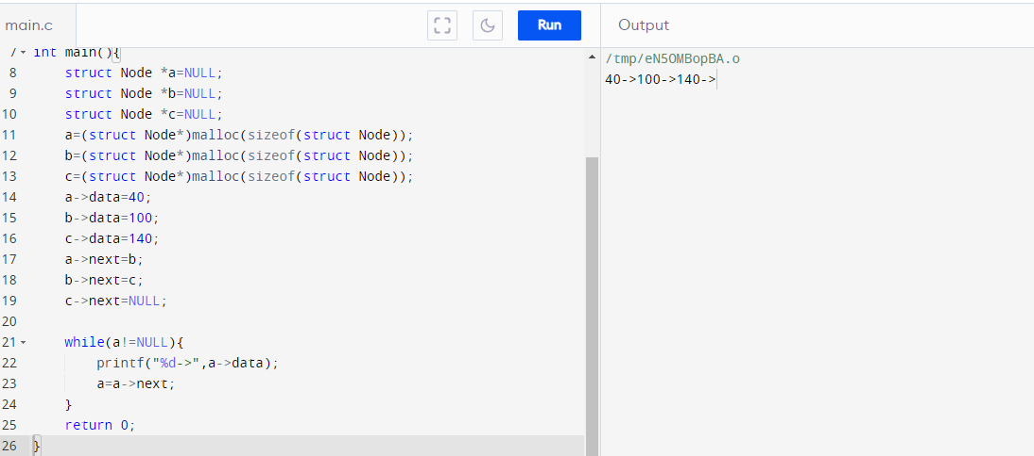

Slide 10
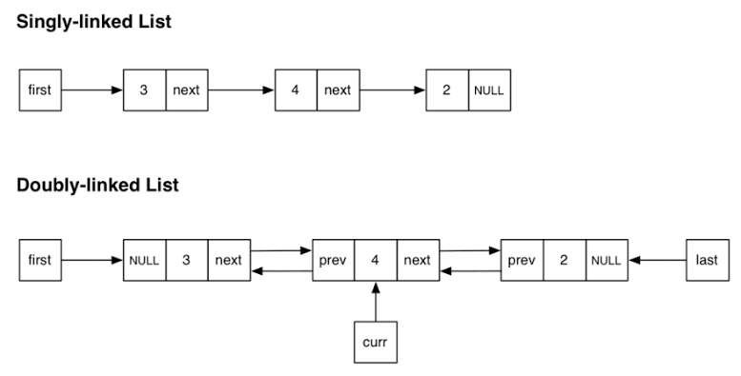
Doubly linked list
Doubly Linked List is a variation of Linked list in which navigation is possible in both ways, either forward and backward easily as compared to Single Linked List.

Slide 11
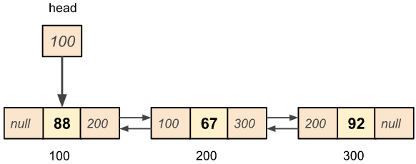
Doubly linked list

Slide 12
A node is represented as:
struct node {
int data;
struct node *next;
struct node *prev;
}
prev | data | next

Slide 13
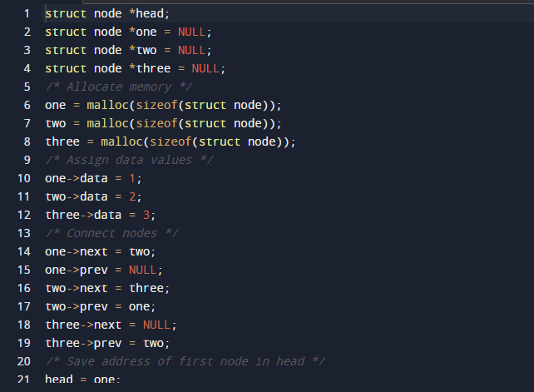
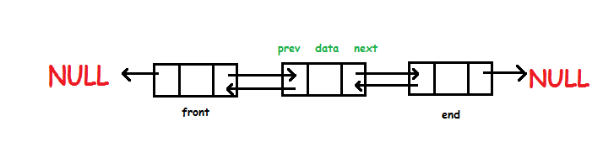
A three member doubly linked list can be created as:

Slide 14
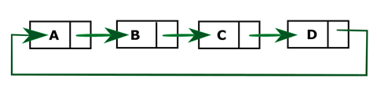
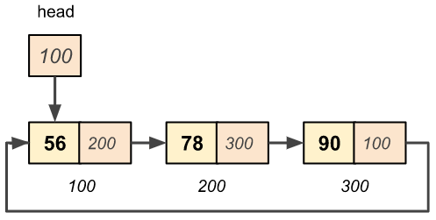
Circular linked list
Circular Linked List is a variation of Linked list in which the first element points to the last element and the last element points to the first element. Both Singly Linked List and Doubly Linked List can be made into a circular linked list.
Singly Linked List as Circular :
In singly linked list, the next pointer of the last node points to the first node.

Slide 15
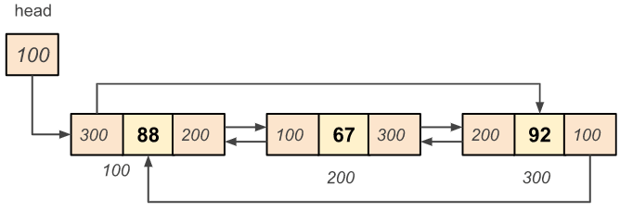
Doubly Linked List as Circular
In doubly linked list, the next pointer of the last node points to the first node and the previous pointer of the first node points to the last node making the circular in both directions.

Slide 16
Representation of circular LINKED LIST
struct Node {
int data;
struct Node * next;
};

Slide 17
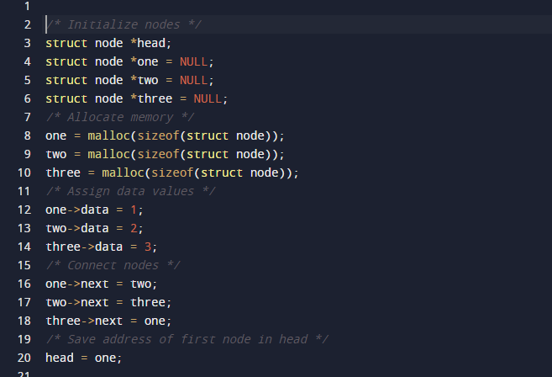
A three-member circular singly linked list can be created as:

Slide 18
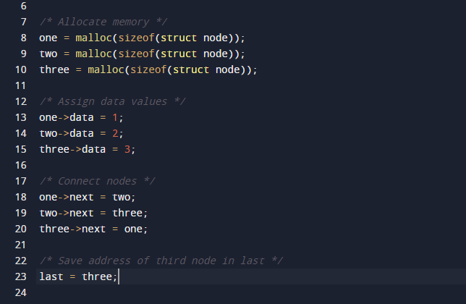

Slide 19
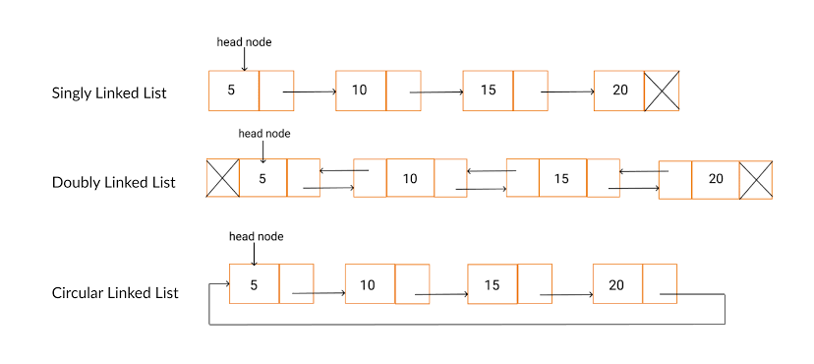

Slide 20
Create a linked list from the array

Slide 21
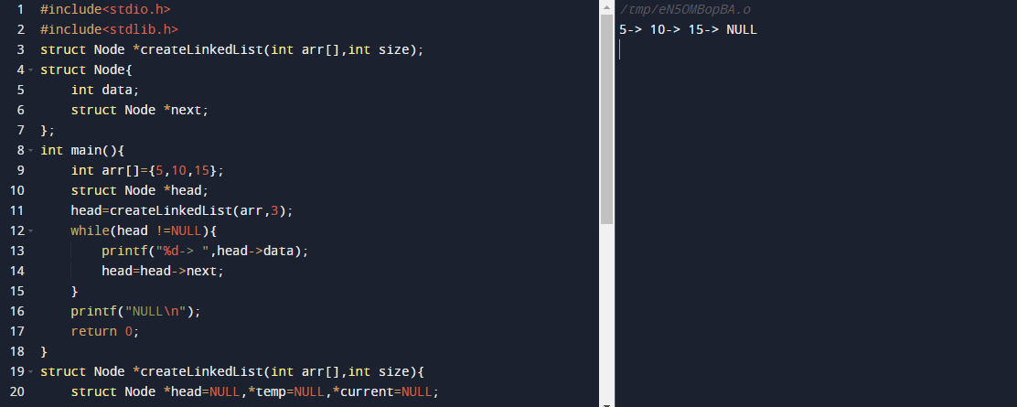
A struct type pointer function!!!!!!

Slide 22
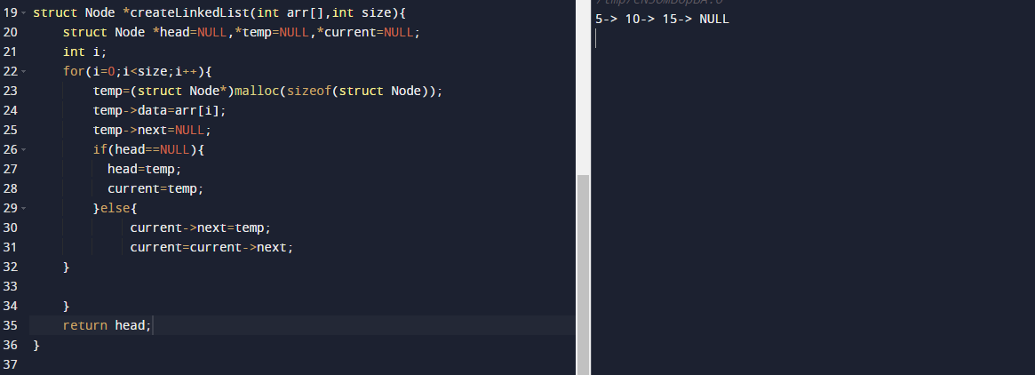
!!!!!!!!!!!!!!!!!!!!!

Slide 23



BASIC OPERATIONS
Insertion − Adds an element at the beginning of the list.
Deletion − Deletes an element at the beginning of the list.
Display − Displays the complete list.
Search − Searches an element using the given key.
Delete − Deletes an element using the given key.

Slide 24
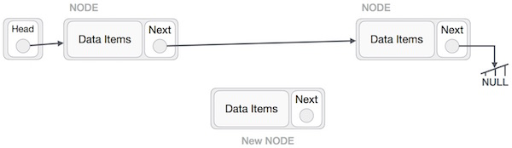
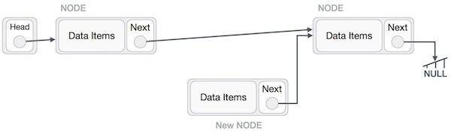
Insertion operation
Adding a new node in linked list is a more than one step activity.

Slide 25
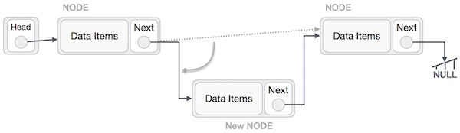
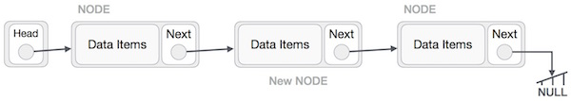

Slide 26
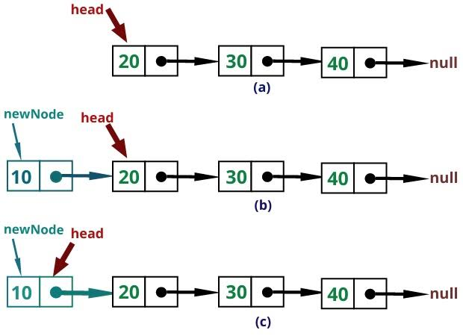
Similar steps should be taken if the node is being inserted at the beginning of the list. While inserting it at the end, the second last node of the list should point to the new node and the new node will point to NULL.

Slide 27
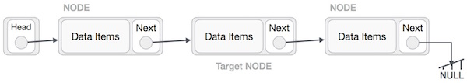
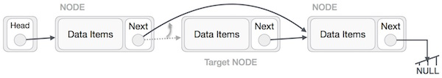
Deletion operation
Deletion is also a more than one step process.. First, locate the target node to be removed, by using searching algorithms.
LeftNode.next −> TargetNode.next;
TargetNode.next −> NULL;

Slide 28
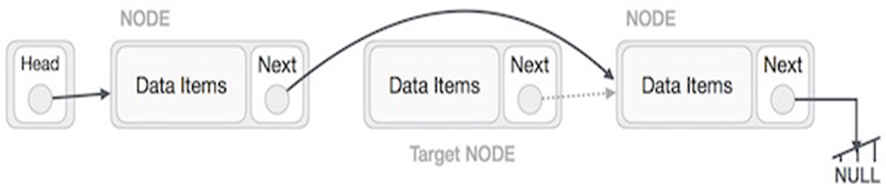
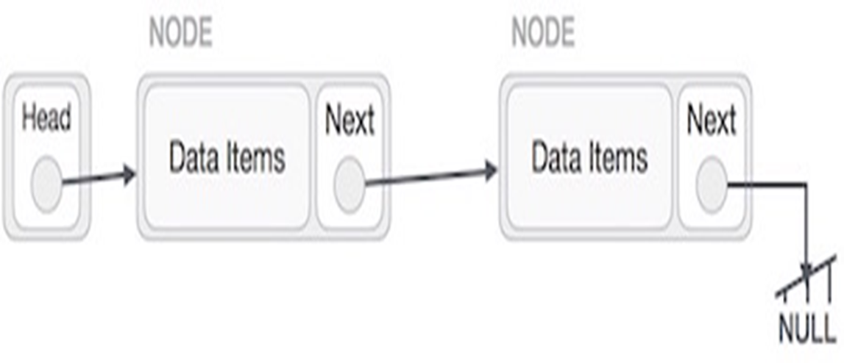
Deletion operation
We need to use the deleted node. We can keep that in memory otherwise we can simply deallocate memory and wipe off the target node completely.

Slide 29
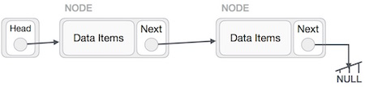
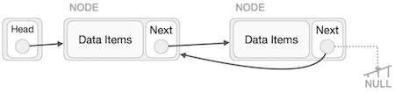
REVERSE OPERATION

Slide 30
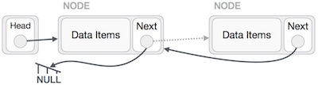
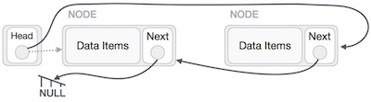


Slide 31
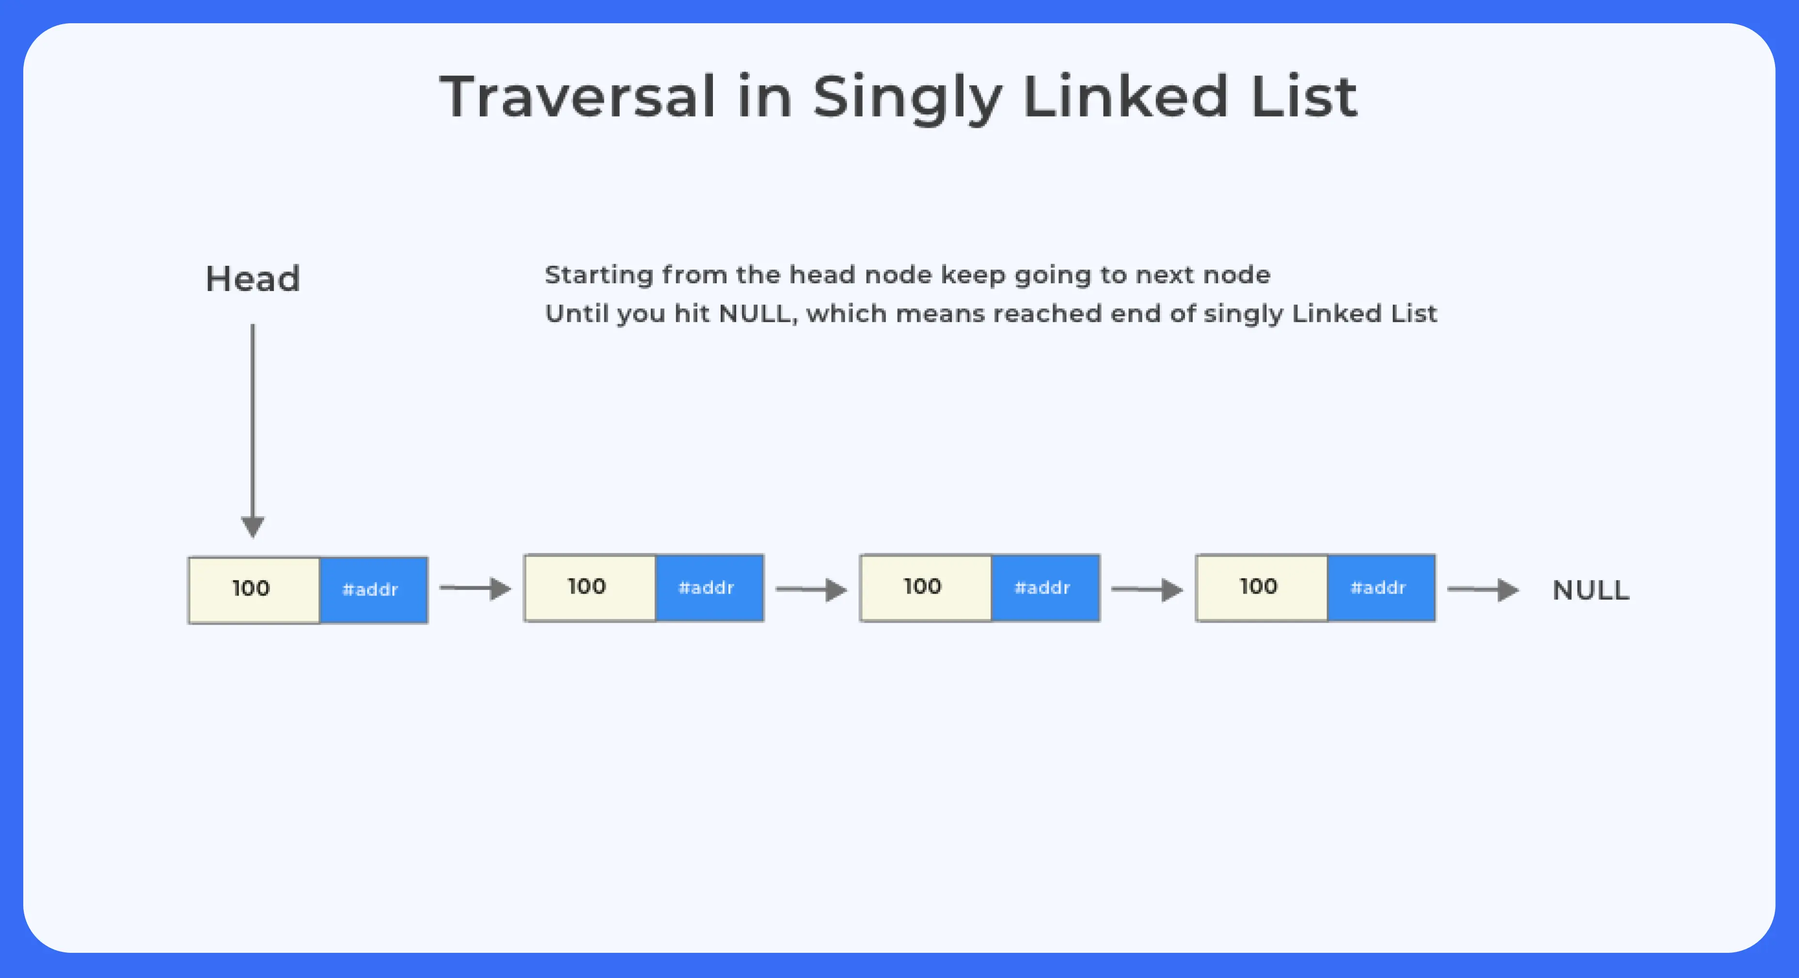
TRAVERSAL IN A SINGLY LINKED LIST
void display(struct Node* node)
{
printf("Linked List: ");
//as linked list will end when Node is Null
while(node!=NULL){
printf("%d ",node->data);
node = node->next;
}
printf("\n");
}

Slide 32
Traverse and search an item in linked list

Slide 33
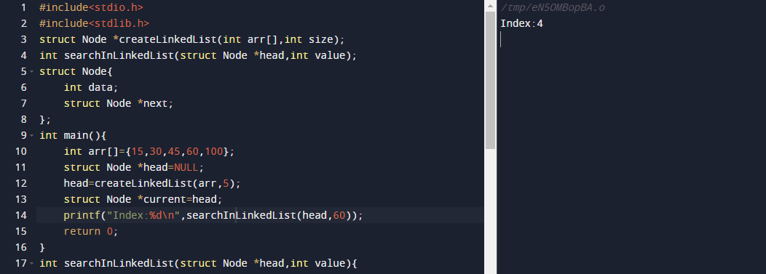
A struct type pointer function!!!!!!

Slide 34

A struct type pointer function!!!!!!

Slide 35
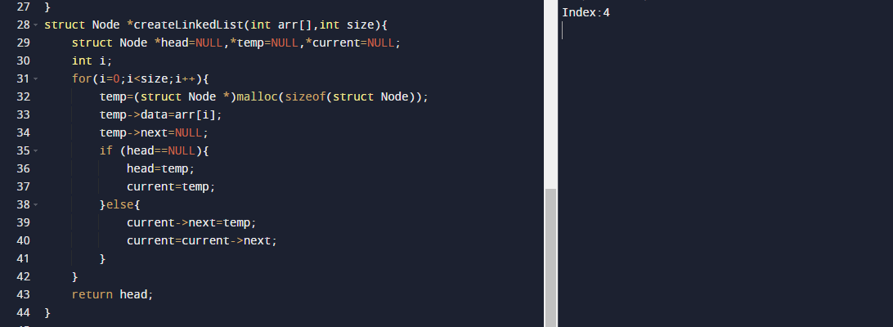
A struct type pointer function!!!!!!

Slide 36
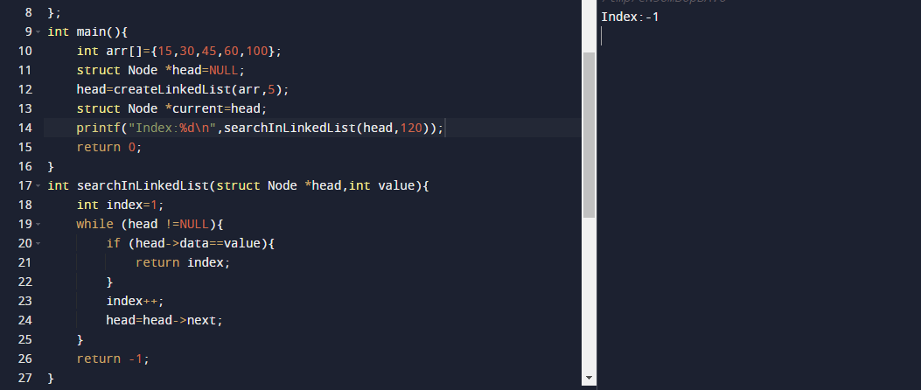
A struct type pointer as a praneter of a function!!!!!!

Slide 37
REVERSE A SINGLY LINKED LIST

Slide 38
5 10 15 NULL
15 10 5 NULL

Slide 39
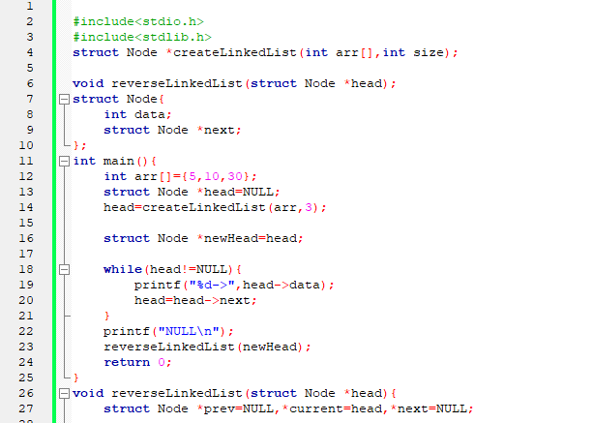

Slide 40
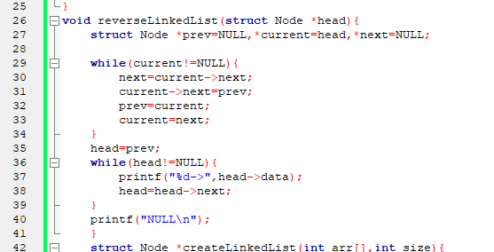

Slide 41
while (current !=NULL){
next= current->next;
current->next=prev;
prev=current;
current=next;
}
head=prev;
prev H C NULL NULL next next= current->next; prev H C NULL NULL next current->next=prev; prev H C NULL NULL next
5
10
15
5
10
15
5
10
15

Slide 42
prev=current;
pre H C
NULL NULL
next
current=next;
pre H C
NULL NULL
next
5
10
15
5
10
15

Slide 43
Next= current->next;
pre H C
NULL NULL
next
current->next=prev;
pre H C
NULL NULL
next
5
10
15
5
10
15

Slide 44
prev=current;
H pre C
NULL NULL
next
current=next;
H pre C
NULL NULL
next
5
10
15
5
10
15

Slide 45
next= current->next;
H pre Curr
NULL NULL
next
current->next=prev;
H pre Curr
NULL NULL
next
5
10
15
5
10
15

Slide 46
prev=current;
H pre Curr
NULL NULL
head=prev;
head
NULL
5
10
15
5
10
15

Slide 48
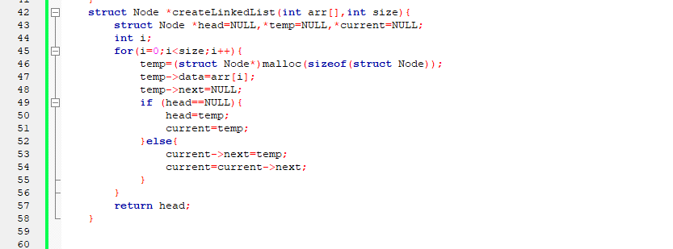

Slide 49
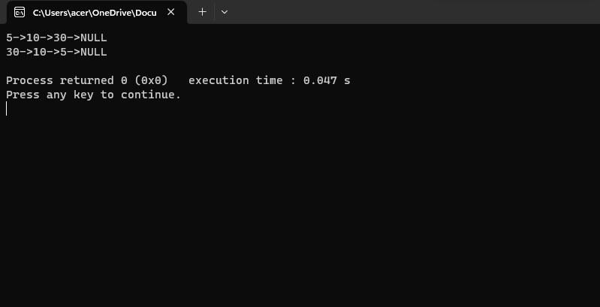

Slide 50
Insert a node in a linked list

Slide 51
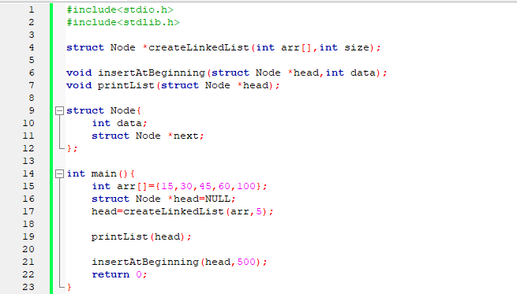

Slide 52
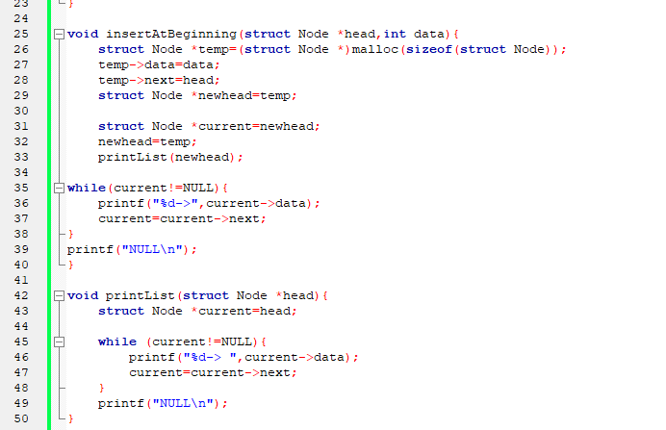

Slide 53
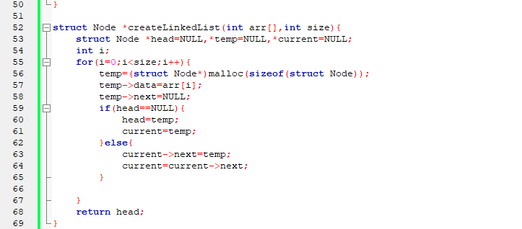

Slide 54


Slide 55
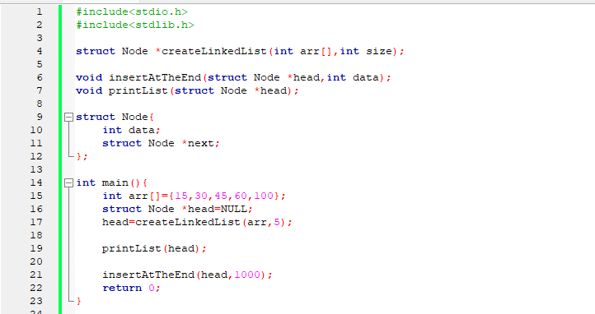

Slide 56
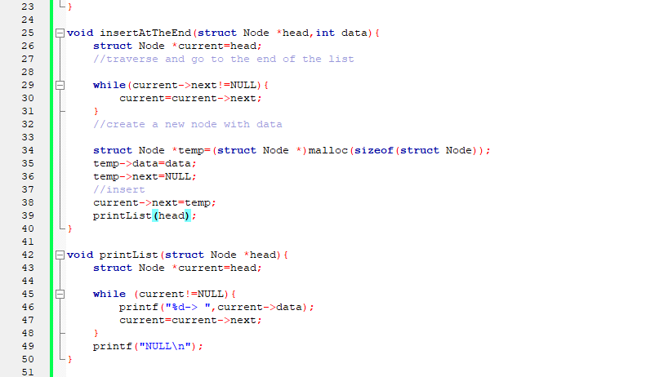

Slide 57
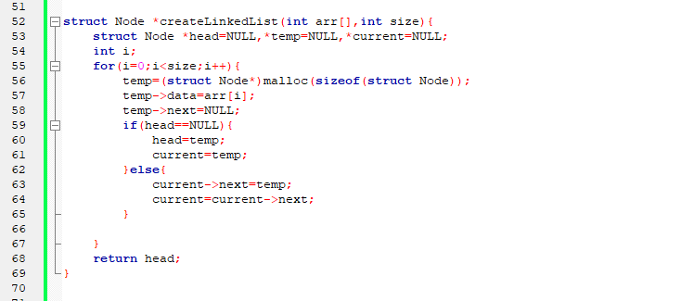

Slide 58
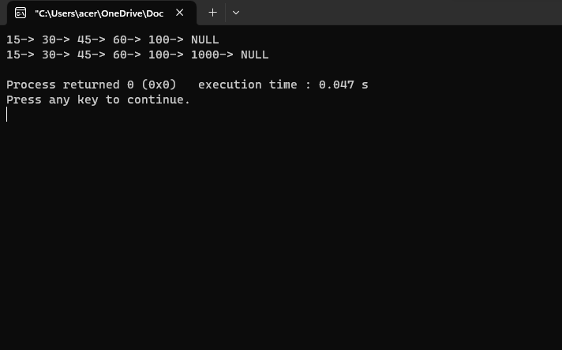

Slide 59
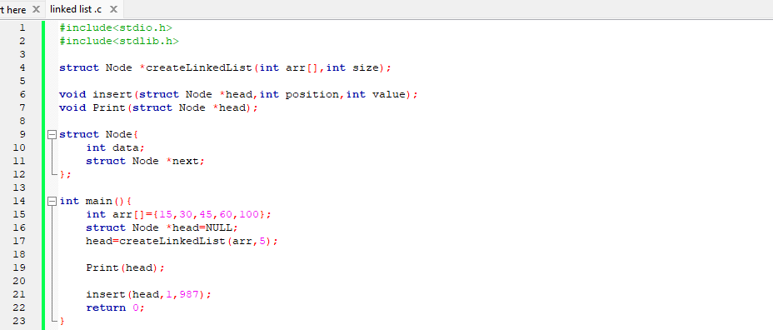
Insert a new node into a linked list (somewhere in the middle)

Slide 60
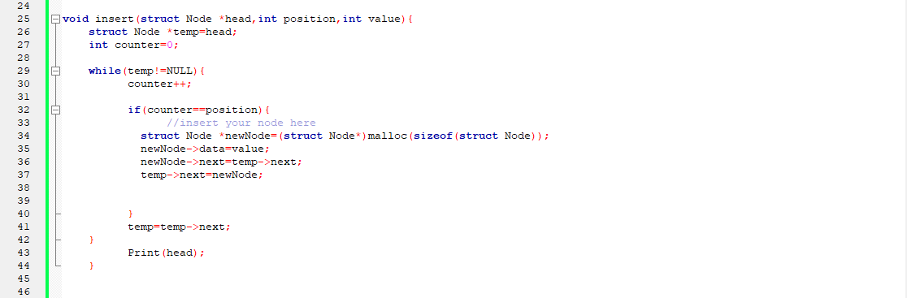
New Node
987
15
30
45
60
100
NULL
temp

Slide 61
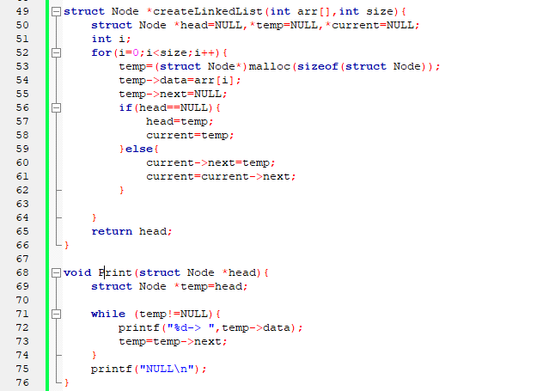

Slide 62
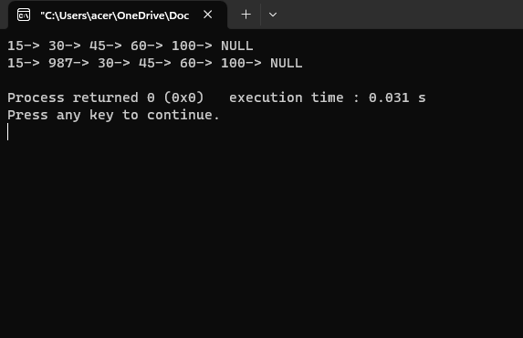

Slide 63
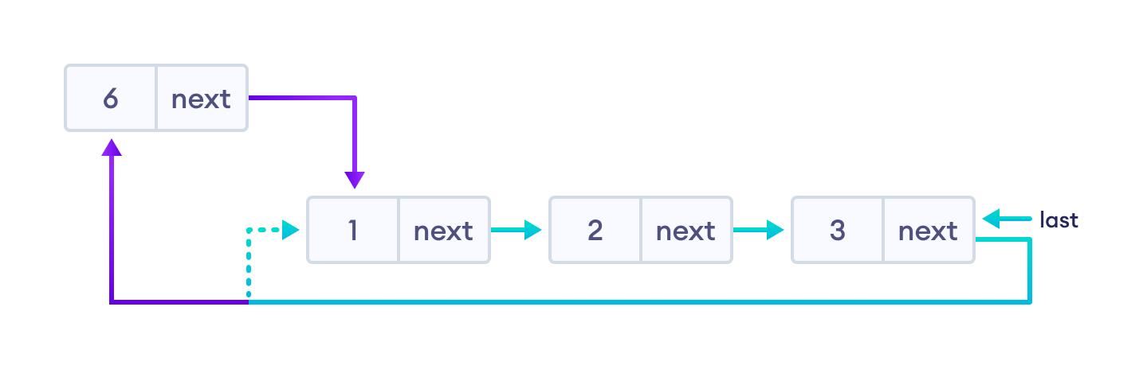
Insertion on a Circular Linked List
We can insert elements at 3 different positions of a circular linked list:
Insertion at the beginning
Insertion in-between nodes
Insertion at the end

Slide 64
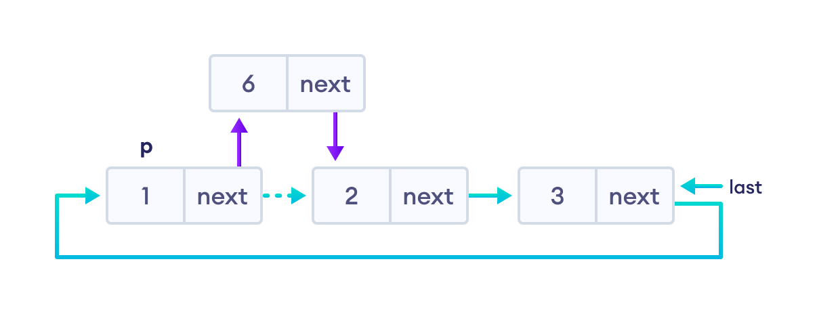


Slide 65


Deletion on a Circular Linked List

Slide 66


Array vs linked list
Array: Arrays store elements in contiguous memory locations, resulting in easily calculable addresses for the elements stored and this allows faster access to an element at a specific index.
Linked List: Linked lists are less rigid in their storage structure and elements are usually not stored in contiguous locations, hence they need to be stored with additional tags giving a reference to the next element.

Slide 67

Difference between array and linked list
We cannot say which data structure is better, between array and linked list. There can be a possibility that one data structure is better for one kind of requirement, while the other data structure is better for another kind of requirement. There are various factors like what are the frequent operations performed on the data structure or the size of the data, and other factors also on which basis the data structure is selected. Now we will see some differences between the array and the linked list based on some parameters.
Cost of accessing an element:
In case of an array, irrespective of the size of an array, an array takes a constant time for accessing an element. In an array, the elements are stored in a contiguous manner, so if we know the base address of the element, then we can easily get the address of any element in an array.

Slide 68

In the linked list, the elements are not stored in a contiguous manner. It consists of multiple blocks, and each block is represented as a node. Each node has two fields, one is for the data field, and another one stores the address of the next node. To find any node in the linked list, we first need to determine the first node known as the head node. If we have to find the second node in the list, then we need to traverse from the first node, and in the worst case, to find the last node, we will be traversing all the nodes.
We conclude that the cost of accessing an element in array is less than the linked list. Therefore, if we have any requirement for accessing the elements, then array is a better choice.
2. Cost of inserting an element
Inserting the element at the beginning:
To insert the new element at the beginning, we first need to shift the element towards the right to create a space in the first position.

Slide 69

In the case of a linked list, to insert an element at the starting of the linked list, we will create a new node, and the address of the first node is added to the new node. In this way, the new node becomes the first node.
Inserting an element at the end :
If the array is not full, then we can directly add the new element through the index. If the array is full, we first need to copy the array into another array and add a new element.
To insert an element at the end of the linked list, we have to traverse the whole list.
Ease of use
The implementation of an array is easy as compared to the linked list. While creating a program using a linked list, the program is more prone to errors like segmentation fault or memory leak. So, lots of care need to be taken while creating a program in the linked list.
Dynamic in size
The linked list is dynamic in size whereas the array is static. Here, static doesn't mean that we cannot decide the size at the run time, but we cannot change it once the size is decided.

Slide 70

3. Memory requirements
As the elements in an array store in one contiguous block of memory, so array is of fixed size. Suppose we have an array of size 7, and the array consists of 4 elements then the rest of the space is unused. The memory occupied by the 7 elements:
In case of linked list, there is no unused memory but the extra memory is occupied by the pointer variables. If the data is of integer type, then total memory occupied by one node is 8 bytes, i.e., 4 bytes for data and 4 bytes for pointer variable.

Slide 71
Array vs linked list
Array | Linked list
An array is a collection of elements of a similar data type. | A linked list is a collection of objects known as a node where node consists of two parts, data and address.
Array elements store in a contiguous memory location. | Linked list elements can be stored anywhere in the memory or randomly stored.
Array works with a static memory. Here static memory means that the memory size is fixed and cannot be changed at the run time. | The Linked list works with dynamic memory. Here, dynamic memory means that the memory size can be changed at the run time according to our requirements.
Array elements are independent of each other. | Linked list elements are dependent on each other. As each node contains the address of the next node so to access the next node, we need to access its previous node.
Array takes more time while performing any operation like insertion, deletion, etc. | Linked list takes less time while performing any operation like insertion, deletion, etc.
Accessing any element in an array is faster as the element in an array can be directly accessed through the index. | Accessing an element in a linked list is slower as it starts traversing from the first element of the linked list.
In the case of an array, memory is allocated at compile-time. | In the case of a linked list, memory is allocated at run time.

Slide 72


